Slide 1
Efficient Encryption Approach Using Discrete-Time Chaotic Maps for Securing the Internet of Robotic Things
Presented by,
Aakash S
Armaan Sahoo
Anirudhan S R

Slide 2
LAYOUT OF THIS PRESENTATION
Abstract
Introduction
Objective
Base Paper
Problem Statement
Literature survey
Proposed technique
Modules
Module Description
Cubic Map Diagrams
Rickers’ Population Model Diagrams
Result
Test & Analysis
Conclusion
References

Slide 3
ABSTRACT
Chaotic systems' unpredictability makes them ideal for encrypting large data like images and videos in Internet-connected robots.
A new lightweight encryption scheme utilizes two discrete-time chaotic maps (the "Cubic Map" and "Ricker's Population Model Map") for efficient encryption.
Keywords: Cryptography, Discrete-time Chaotic Map, Lightweight Encryption, Internet of Robotic Things (IoRT), Cryptanalysis, Hem Cubic Map, Ricker’s Population Map, Number of Pixels Change(NPCR),Unified Average Changing Intensity(UACI).

Slide 4
INTRODUCTION
Robotic devices' growing interconnectivity in diverse fields demands strong security protocols to protect sensitive information and maintain communication integrity.
Traditional encryption techniques are not suitable for robotic networks due to their high computational overhead and resource demands.
Implementing discrete-time chaotic maps offers a lightweight and efficient solution to address the security challenges within the Internet of Robotic Things.

Slide 5
OBJECTIVE
To develop a lightweight encryption mechanism designed for IoRT environments.
To validate the effectiveness, feasibility, and suitability of the proposed mechanism for practical deployment in IoRT applications.
To provide a scalable solution that can meet the unique requirements of Internet-enabled robotic networks.

Slide 6
BASE PAPER
Harun Emre Kiran, Akif Akgul, Oktay Yildiz, Emre Deniz,"Lightweight encryption mechanism with discrete-time chaotic maps for Internet of Robotic Things", ScienceDirect, Integration,Volume 93, ISSN 0167-9260, 102047, 2023.

Slide 7
PROBLEM STATEMENT
To develop an efficient encryption approach using Discrete-Time Chaotic Maps for securing the Internet of Robotic Things.

Slide 8
LITERATURE SURVEY
AUTHOR | TITLE | APPROACH DESCRIPTION AND ACHIEVEMENTS | LIMITATIONS/OBSERVATION | YEAR
Harun Emre Kiran,Akif Afgul | Lightweight encryption mechanism with discrete-time chaotic maps for Internet of Robotic Things | A lightweight encryption mechanism utilizing discrete-time chaotic maps designed for securing communication within the Internet of Robotic Things (IoRT) environments. Focuses on enhancing security and efficiently operating on resource-constrained robotic devices. Outperforms existing systems by 15 times in 256 × 256 images and by 6 times in 512 × 512 images. | Balance between security and computational efficiency in highly dynamic IoRT environments | 2023
H.M. Elhosany, O.S. Faragallah | Chaotic encryption of images in the fractional Fourier transform domain using different modes of operation | Implements 2-D chaotic Baker map integrated with Fractional Fourier Transform for encrypting digital images. Employs Cipher Block Chain, Cipher Feed-Back, and Output Feed-Back, with the Initialization Vector serving as the primary key. | Higher computational complexity Increased vulnerability to noise | 2013

Slide 9
LITERATURE SURVEY (Cond..)
AUTHOR | TITLE | APPROACH DESCRIPTION AND ACHIEVEMENTS | LIMITATION/OBSERVATION | YEAR
Pourjabbar Kari | A new image encryption scheme based on hybrid chaotic maps | Combines Discrete Wavelet Transform (DWT) with chaotic maps for permutation and diffusion. Offers low residual intelligibility, sensitivity, and strong security performance. Effectiveness against common attacks. | Does not sufficiently consider the complexity and security needs of specific applications. | 2020
M.Z. Talhaoui | A new one-dimensional chaotic map and its application in a novel permutation-less image encryption scheme | Implements one - dimensional cosine fractional chaotic map. Emphasizes chaotic behavior, and heightened sensitivity to initial conditions. Develops a rapid image encryption method, employing a permutation-less design for enhanced speed. | Suffers from limited randomness due to its deterministic nature. | 2020

Slide 10
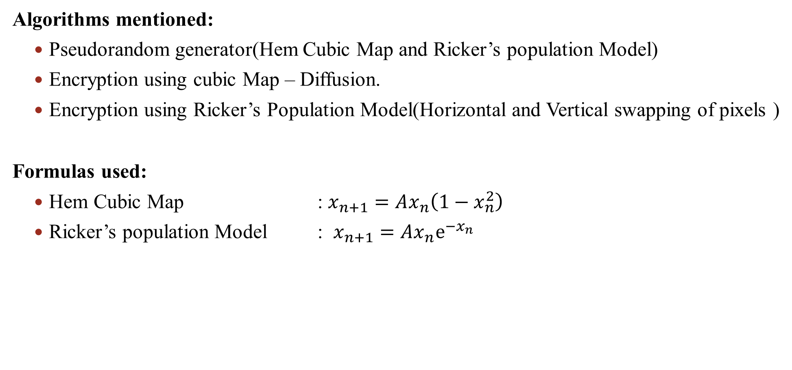
Algorithms
Algorithms mentioned:
Pseudorandom generator(Hem Cubic Map and Ricker’s population Model)
Encryption using cubic Map – Diffusion.
Encryption using Ricker’s Population Model(Horizontal and Vertical swapping of pixels )
Formulas used:
Hem Cubic Map : $x_{n+1}=Ax_{n}\left(1−x_{n}^{2}\right)$
Ricker’s population Model : $x_{n+1}=Ax_{n}ⅇ^{−x_{n}}$

Slide 11
PROPOSED TECHNIQUE
SOURCE IMAGE
ENCRYPTED IMAGE
ENCRYPTION USING
CUBIC MAP
DECRYPTION USING RICKER’S POPULATION MODEL
ENCRYPTION USING
RICKER’S POPULATION MODEL
DECRYPTION USING
CUBIC MAP
ENCRYPTED IMAGE
DECRYPTED IMAGE
Encryption
Decryption

Slide 12
MODULES
Module 1: Pseudo Random Number Generator Module (PRNG)
- Sub-module 1: Implements the Cubic Map to generate random numbers.
- Sub-module 2: Implements the Ricker's Map to generate random numbers.
Module 2: Encryption and Decryption Module
- Sub-module 1: Performs encryption through Cubic, Ricker’s Horizontal, and Ricker’s Vertical Algorithms using the PRNG module.
- Sub-module 2: Performs decryption through Ricker’s Vertical, Ricker’s Horizontal, and Cubic Algorithms using the PRNG module.

Slide 13
MODULES
Module 3: Split And Merge Module
- Handles input images by splitting and merging it.
Module 4: Accuracy And Efficiency Module
- Provides the accuracy of the decryption.
- Analyzes the efficiency of the algorithms.

Slide 14
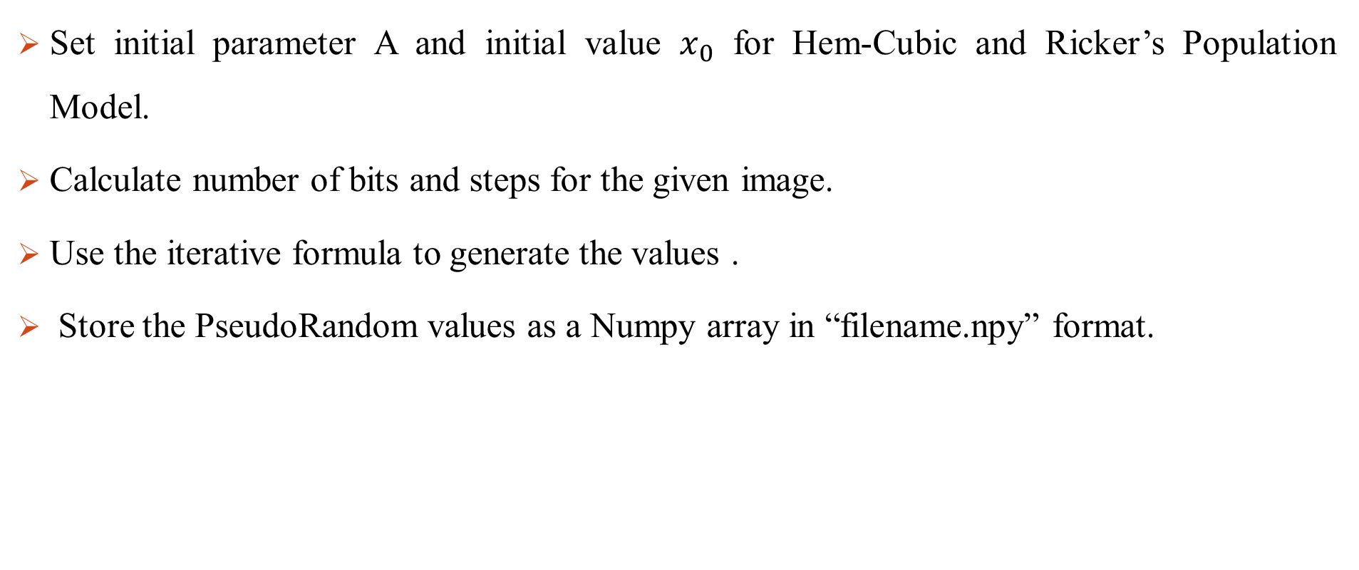
Module 1: Pseudo Random Number Generator Module (PRNG)
Set initial parameter A and initial value $x_{0}$ for Hem-Cubic and Ricker’s Population Model.
Calculate number of bits and steps for the given image.
Use the iterative formula to generate the values .
Store the PseudoRandom values as a Numpy array in “filename.npy” format.

Slide 15
Module 2: Encryption and Decryption Module
Encryption | Decryption
Load the input image/block Encrypt the image/block using cubic map Encrypt the generated image using Ricker’s horizontal map Encrypt the generated image using Ricker’s vertical map Store the encrypted image | Load the encrypted image/block Decrypt the image/block using Ricker’s vertical map Decrypt the generated image using Ricker’s horizontal map Decrypt the generated image using Cubic map Store the decrypted image

Slide 16
Module 3: Split And Merge Module
Input the image and block size.
Split the image into blocks and encrypt/decrypt each block.
Combine the encrypted/decrypted blocks into single image.

Slide 17
Module 4: Accuracy And Efficiency Module
Input the source and decrypted image and check for accuracy.
Perform the following tests to evaluate efficiency :
Correlation
Entropy
Number Of Pixel Change Rate(NPCR)
Unified Average Change Intensity(UACI)

Slide 18
CUBIC MAP DIAGRAMS

Slide 19
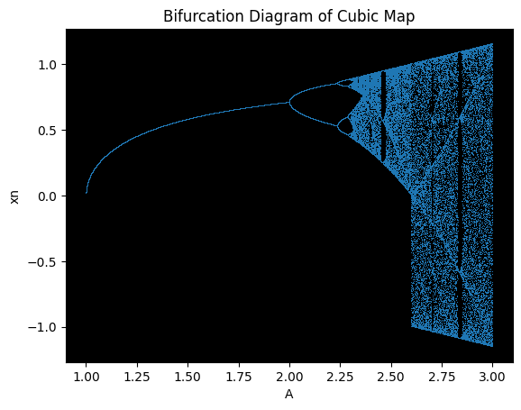
BIFURICATION DIAGRAM

Slide 20
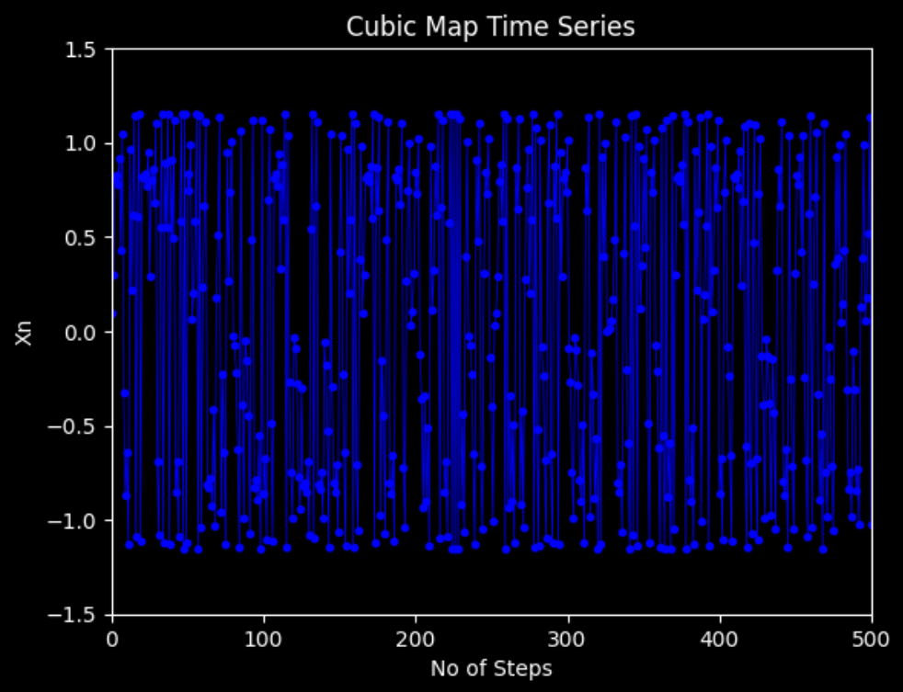
TIME SERIES

Slide 21
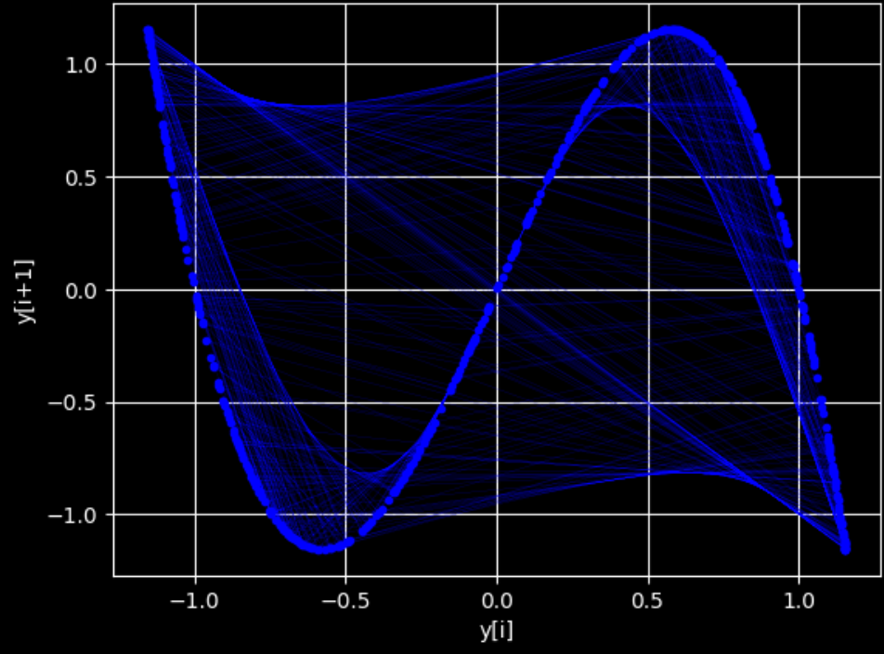
MAP FUNCTION

Slide 22
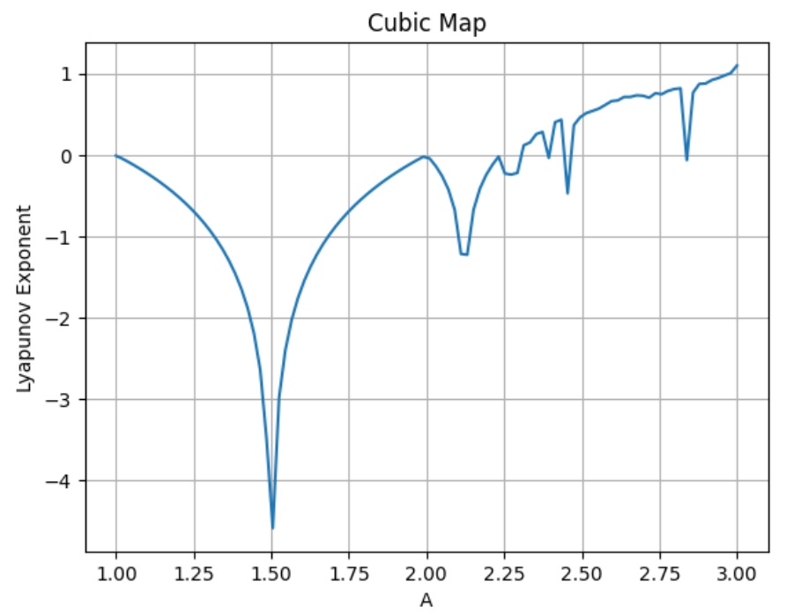
LYAPUNOV EXPONENT

Slide 23
RICKER’S POPULATION MODEL DIAGRAMS

Slide 24
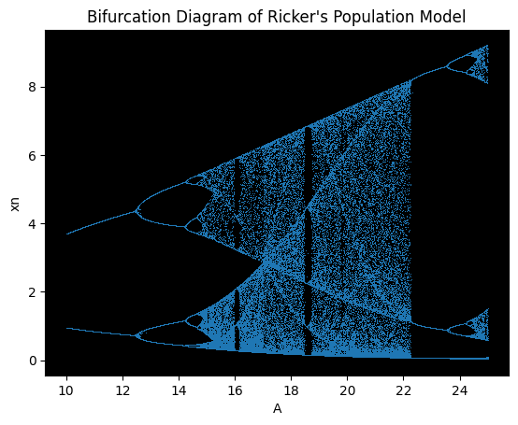
BIFURICATION DIAGRAM

Slide 25
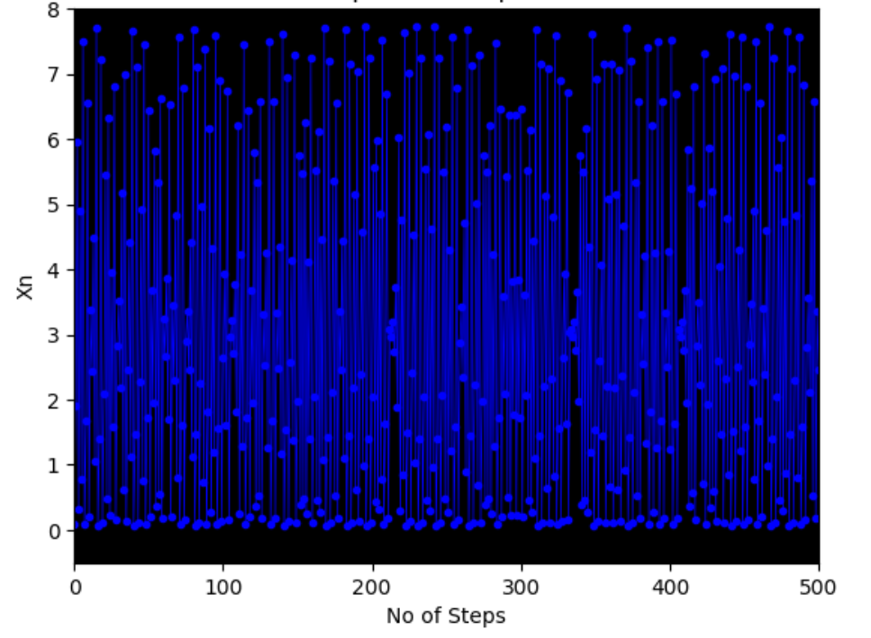
TIME SERIES

Slide 26
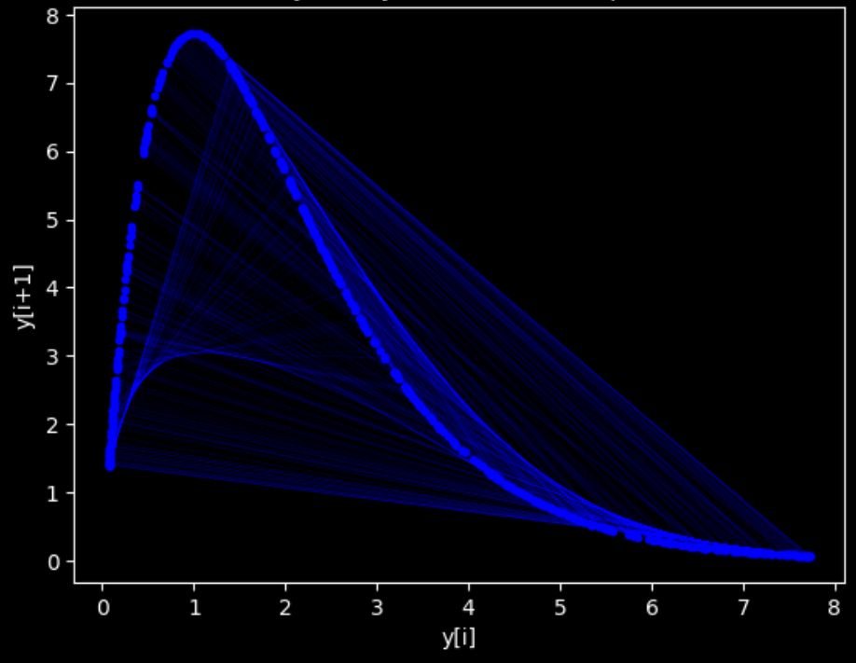
MAP FUNCTION

Slide 27
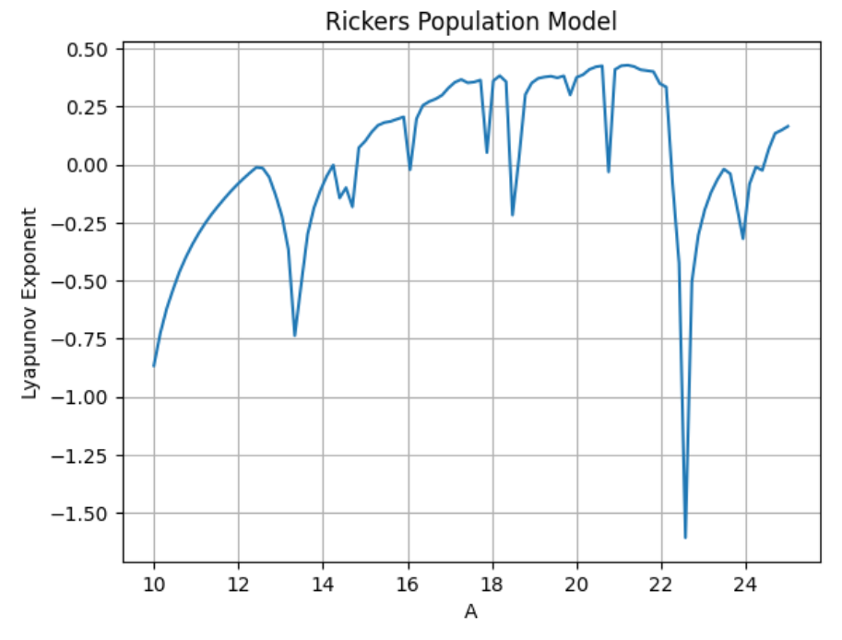
LYAPUNOV EXPONENT

Slide 28
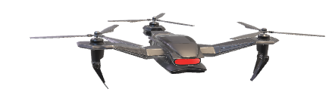
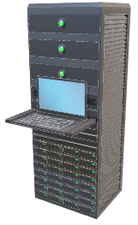
Frame1 is Encrypted by client
Encrypted Frame1 is broadcast to be sent to server
Sending Encrypted Data
Encrypted Frame1 obtained and decrypted
Frame1 is processed and its results encrypted to be sent back to client
Encrypted data is broadcast to the robot
Sending Encrypted Data

Slide 29
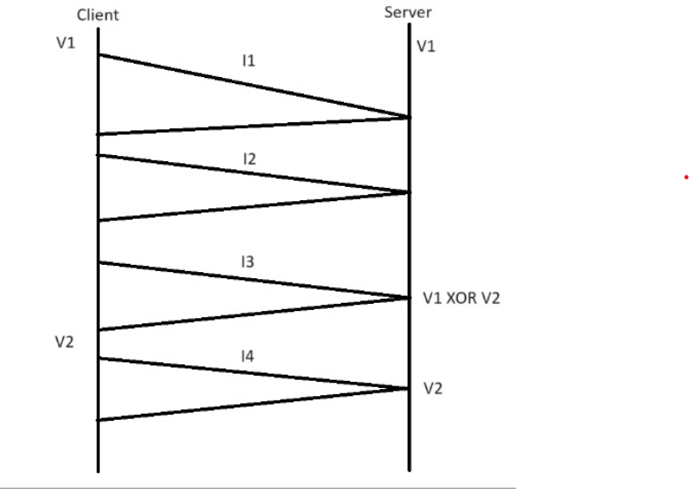
Iterative Approach to Exchange Versions

Slide 30



Result
Input image
Cubic encrypted image
Ricker’s Horizontal encrypted image

Slide 31

Result
Ricker’s Vertical encrypted image(Final encrypted)
Ricker’s Vertical decrypted image
Ricker’s Horizontal decrypted image

Slide 32
Result
Cubic decrypted image(Final decrypted)
Input image

Slide 33
Test & Analysis
The following tests were performed to evaluate efficiency :
Correlation
Entropy
Number Of Pixel Change Rate(NPCR)
Unified Average Change Intensity(UACI)
Histogram

Slide 34
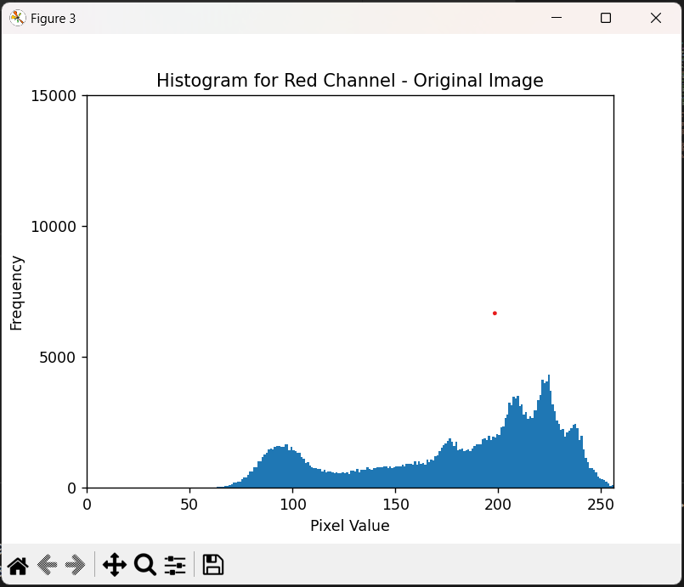
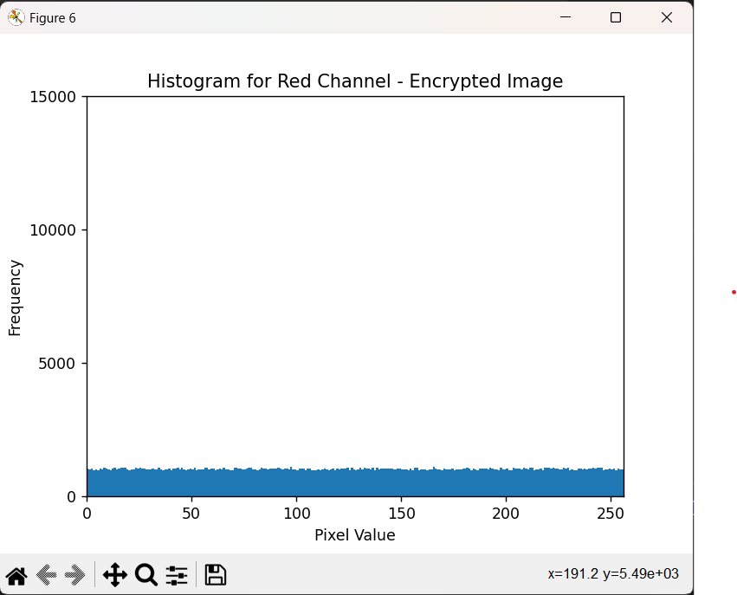
Histogram Testing
Red Channel (Original)
Red Channel (Encrypted)

Slide 35
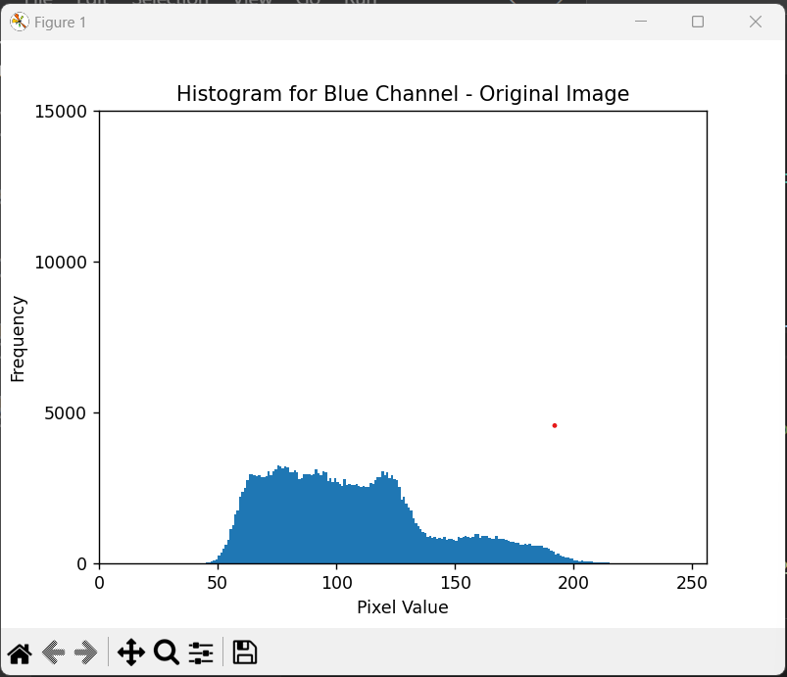
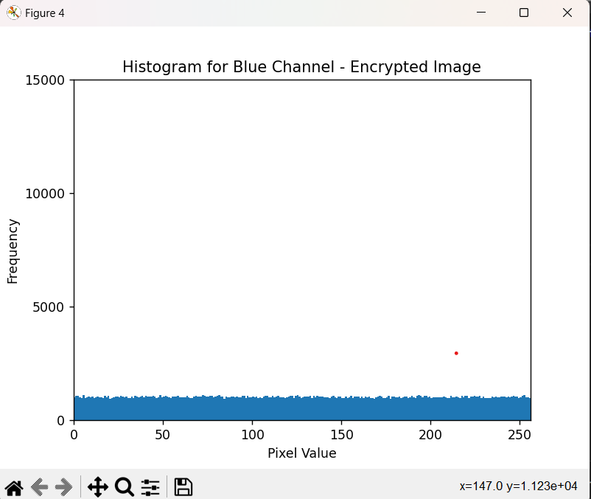
Histogram Testing
Blue Channel (Original)
Blue Channel (Encrypted)

Slide 36
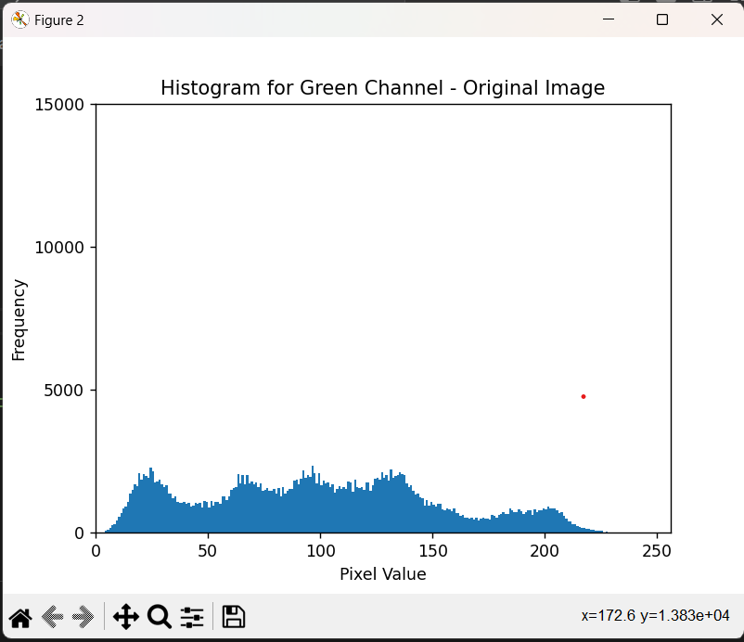
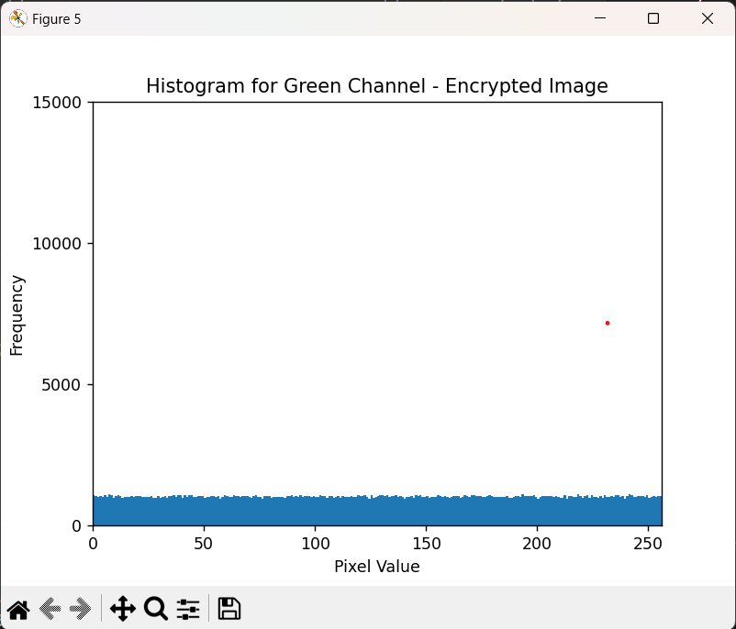
Histogram Testing
Green Channel (Original)
Green Channel (Encrypted)

Slide 37
NPCR,UACI & Entropy Testing
Size | Channel | NPCR | UACI | Entropy (Original) | Entropy (Encrypted)
512 | Red | 99.60670471191406% | 27.57409189261642% | 6.968426919463017 | 7.999160255335854
512 | Green | 99.59754943847656% | 30.638421750536153% | 7.594037882295092 | 7.999308460338932
512 | Blue | 99.5941162109375% | 33.077392578125% | 7.253102328431045 | 7.999377270974322

Slide 38
Correlation Testing
Size | Channel | Vertical Correlation (original) | Vertical Correlation (Encrypted)
512 | Red | 0.9893149330433243 | -0.002356294929376079
512 | Green | 0.9824932655920957 | 0.0013853849166200962
512 | Blue | 0.9576047473084145 | -0.0002418198911871894

Slide 39
Correlation Testing
Size | Channel | Horizontal Correlation (original) | Horizontal Correlation (Encrypted)
512 | Red | 0.9797731283414576 | 0.00029889143504534406
512 | Green | 0.9690659450690449 | 9.348173976736638e-05
512 | Blue | 0.9327410008602103 | 9.988888632052652e-05

Slide 40
CONCLUSION
Provides a streamlined encryption mechanism designed for robotic systems to enhance the efficiency of encrypting large-scale data.
Offers a versatile solution to challenges posed by the dynamic and heterogeneous nature of robotic networks.
Analyses decrypted images using correlation, NPCR, UACI, and entropy tests to measure the quality.

Slide 41
REFERENCES
1. Harun Emre Kiran, Akif Akgul, Oktay Yildiz, Emre Deniz ,
"Lightweight encryption mechanism with discrete-time chaotic maps for Internet of Robotic Things", ScienceDirect , Integration,Volume 93, ISSN 0167-9260, 102047, 2023.
2. H.M. Elhosany, H.E. Hossin, H.B. Kazemian, O.S. Faragallah, “Chaotic encryption of images in the fractional Fourier transform domain using different modes of operation” , in: 2012 29th National Radio Science Conference (NRSC), IEEE, 2012, pp. 223–235.
3. A. Pourjabbar Kari, A. Habibizad Navin, A.M. Bidgoli, M. Mirnia, “A new image encryption scheme based on hybrid chaotic maps” , Multimedia Tools Appl. 80 (2) (2021) 2753–2772.
4. M.Z. Talhaoui, X. Wang, A. Talhaoui, “A new one-dimensional chaotic map and its application in a novel permutation-less image encryption scheme” , Visual Computer 37 (7) (2021) 1757–1768

Slide 42
THANK YOU

